Slide 1
STRUCTURE & THEMEING
Now we have our components…let’s make them beautiful

Slide 2
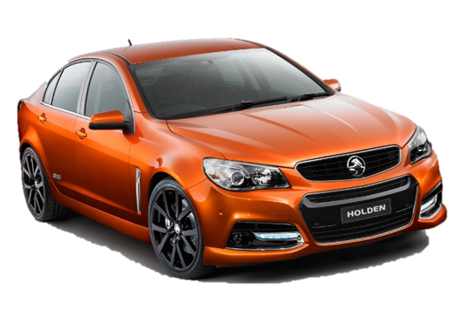


Remember Our Car?
Let’s think back to our car…
Think about a car – all cars are built on a similar structure. Elements can be moved and resized but this is always the same.
Yet to make the car more attractive and more functional we add parts to it, we’ll call these attributes.

Slide 3
Remember Our Car?
Lets pretend we are building our car using HTML. What would we start with? For now lets just focus on the frame.
All the structural parts of our car start out as tags as HTML is made up of a set of tags. And tags have two parts a start <tag> and an end </tag>.
<Frame></Frame> - Here’s or basic frame, but this is boring and will not sell, so we add in our attributes.
<Frame mirrors windows></Frame> - But it’s still a bit bland, so we mix in some properties.
<Frame mirrors=“chrome” windows=“50%”></Frame> - Now we have an interesting frame for our car.
Finally we put what matters the most in our car, the whole reason it was built in the first place …people!
<Frame mirrors=“chrome” windows=“50%”> People</Frame>
That’s the basics of HTML!

Slide 4
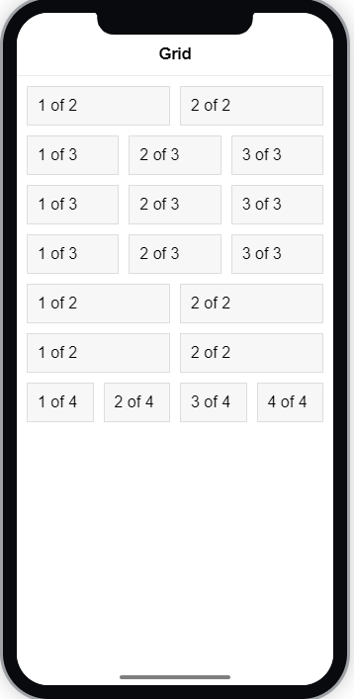
With that in mind….
…let’s see how we organise our Ionic pages.
We use The Grid System which is the most powerful mobile-first grid system currently on the web.
And it’s comprised of 3 parts:
Grid <ion-grid>
Rows <ion-row>
Columns <ion-col size=“x”>
Grids contain Rows and Rows contain Columns

Slide 5
Grid Customisation
Columns will expand to fill the row, and will resize to fit additional columns.
It is based on a 12 column layout with different breakpoints based on the screen size. The number of columns can be customized using CSS.

Slide 6
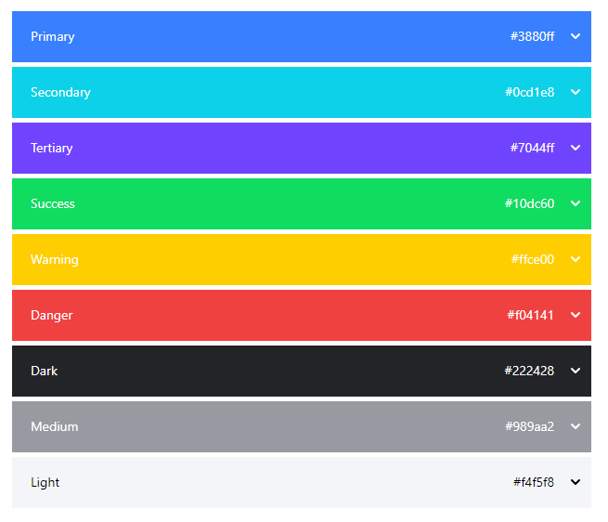
Theming
Now we have our content organised, we can really start to think about how it might look.
Ionic comes with a built-in theme (as shown to the right)
All of the Ionic components are themed using CSS properties.
<ion-* color=“primary”>

Slide 7
Theme Modification
To modify a theme all variations for that colour should be set. For example, to change the secondary color to #006600, set the following CSS properties:
:root { --ion-color-secondary: #006600; --ion-color-secondary-rgb: 0,102,0; --ion-color-secondary-contrast: #ffffff; --ion-color-secondary-contrast-rgb: 255,255,255; --ion-color-secondary-shade: #005a00; --ion-color-secondary-tint: #1a751a; }
When secondary is applied to a button not only is the
base colour #006600 used
but the contrast colour #FFFFFF is used for the text
along with shade #005A00
tint #1A751A colours
for different states of the button
These colours all make up our app brand

Slide 8
Theme Additions
To add a new color, create a class that defines all of the variations using CSS variables for that color. The class should be written as .ion-color-{COLOR}. For example, to add a color called favorite, the following class could be added:
.ion-color-favorite { --ion-color-base: #69bb7b; --ion-color-base-rgb: 105,187,123; --ion-color-contrast: #ffffff; --ion-color-contrast-rgb: 255,255,255; --ion-color-shade: #5ca56c; --ion-color-tint: #78c288; }
Once added the colour can be used on any component that supports the color property
<ion-button color="favorite"> Favorite</ion-button>
Bare in mind however, this colour class cannot be used as a normal CSS property as it specifically specifies a theme colour

Slide 9
CHALLENGE TIME!
Organise your content using the grid system
Look back at your design and come up with a colour theme
You can used tools such as http://paletton.com/ to make a contrasting theme
Once you have a theme, apply this to your mobile application
For bonus points add some extra colours and apply them to at least one component
Share a screen shot of your newly themed content on our Discord Community!

